Slide 1

ENSEMBLE METHODS

Slide 2

ENSEMBLE METHODS

Slide 3

WHAT ARE ENSEMBLE METHODS?
During the Lockdown I decided to improve my cooking skills.
I'm quite happy with my results but I feel I should get external validation. What are my choices?
Data Squad | Ensemble Learning

Slide 4

WHAT ARE ENSEMBLE METHODS?
I'm quite happy with my results but I feel I should get external validation. What are my choices?
1 - Ask Chef Ramsay
Data Squad | Ensemble Learning

Slide 5
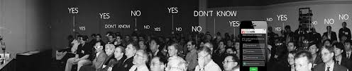
WHAT ARE ENSEMBLE METHODS?
I'm quite happy with my results but I feel I should get external validation. What are my choices?
2 - Ask all my family members, friends and students to vote
Data Squad | Ensemble Learning

Slide 6
WHAT ARE ENSEMBLE METHODS?
Ensemble methods base themselves on the idea that the average opinion of several weak predictors will yield a strong predictor.
A Group of predictors is called an Ensemble, thus the Ensemble learning method
Data Squad | Ensemble Learning

Slide 7
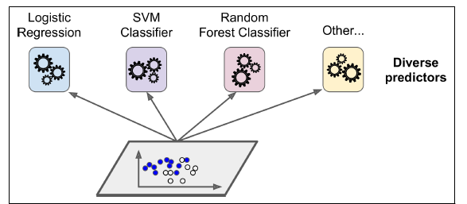
VOTING CLASSIFIERS
Train individually the algorithms that we have seen so far and then take a vote of the answers!
Process of voting classifiers:
- train individually each algorithm
- save all the generated models in a function
Data Squad | Ensemble Learning

Slide 8
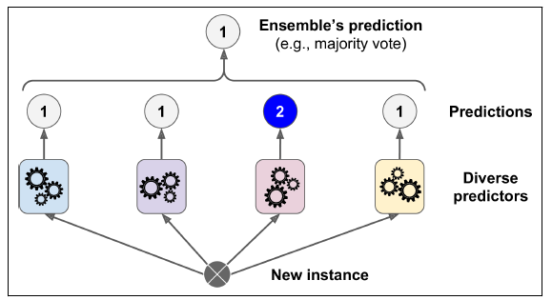
VOTING CLASSIFIERS
Train individually the algorithms that we have seen so far and then take a vote of the answers!
Once you receive a new instance (data point) you can then pass it through all the algorithms and perform a majority vote of the answer (classification problem)
Data Squad | Ensemble Learning

Slide 9
STACKING
Why can't we take this one step further and have our ensemble of weak classifiers and then have one final algorithm that "learns" the best way to perform the final decision?
This is an alternative to using a naive majority vote or average
Let's train a model to perform this aggregation
Data Squad | Ensemble Learning

Slide 10
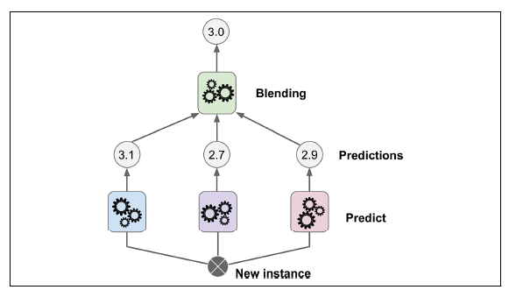
STACKING
Why can't we take this one step further and have our ensemble of weak classifiers and then have one final algorithm that "learns" the best way to perform the final decision?
This is an alternative to using a naive majority vote or average
Let's train a model to perform this aggregation
Data Squad | Ensemble Learning

Slide 11
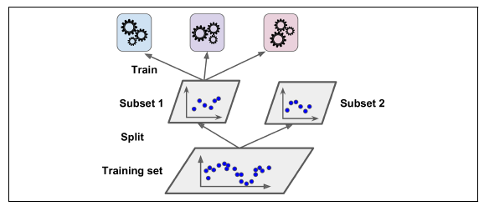
STACKING
In practice this is done in two steps:
From your training dataset, leave out a subset to then be used to train the blending algorithm.
Perform your usual training
Data Squad | Ensemble Learning

Slide 12
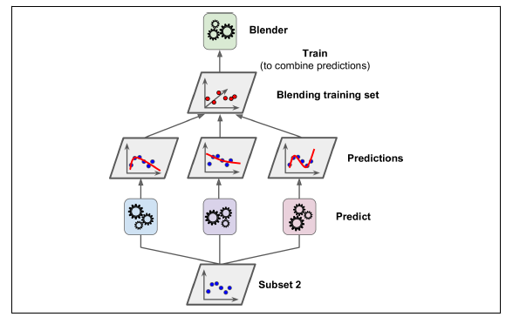
STACKING
In practice this is done in two steps:
Use the second subset that the trained weak predictors have never seen before to make them make predictions.
Finally with these predictions a final belding algorithm will be trained to find the best way to combine the predictions
Data Squad | Ensemble Learning

Slide 13
VOTING CLASSIFIERS
when can this go wrong?
Well, this is a great voting system if all algorithms are truly independent of each other and will not tend to overfit in the same way or have the same weaknesses.
If they are not independent, you are simply giving more weight to inaccurate predictions.
hence the importance of having diverse classifiers
Data Squad | Ensemble Learning

Slide 14
BAGGING AND PASTING
So how can we make sure that we create independent classifiers?
One way is to always use the same algorithm but then train it on a different random sample of the training dataset.
Bagging - When random sample is taken with replacement
Pasting - When random sample is taken without replacement
Data Squad | Ensemble Learning

Slide 15
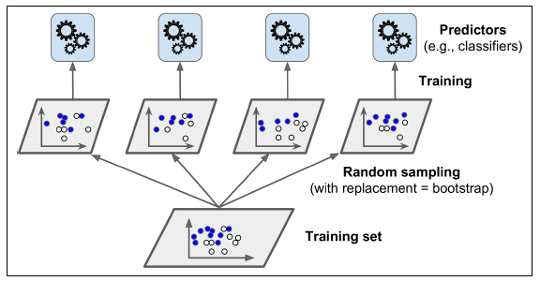
BAGGING AND PASTING
Data Squad | Ensemble Learning

Slide 16
BAGGING AND PASTING
Each individual predictor has a higher bias than if it were trained on the original training set, but the final aggregation reduces the overall bias
Data Squad | Ensemble Learning

Slide 17
BAGGING AND PASTING
Each individual predictor has a higher bias than if it were trained on the orisinal training set, but the final aggregation reduces the overall bias
can be made very performant if process if parallelized
Data Squad | Ensemble Learning

Slide 18
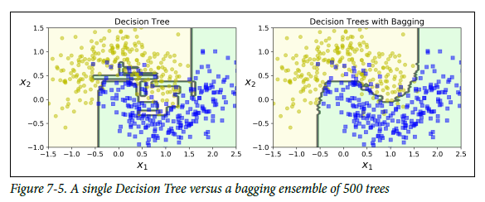
BAGGING AND PASTING - EXAMPLE
Data Squad | Ensemble Learning

Slide 19
RANDOM PATCHES METHOD
The previous methods randomized the training data used. What else could we randomize?
Data Squad | Ensemble Learning

Slide 20
RANDOM PATCHES METHOD
The previous methods randomized the training data used. What else could we randomize?
The FEATURES
Data Squad | Ensemble Learning

Slide 21
RANDOM PATCHES METHOD
The previous methods randomized the training data used. What else could we randomize?
The FEATURES
By repeating the algorithm training process randomizing both the training data subset but also the features chosen to perform the training is called the Random Patches Method
Data Squad | Ensemble Learning

Slide 22
RANDOM PATCHES METHOD
The previous methods randomized the training data used. What else could we randomize?
The FEATURES
By repeating the algorithm training process randomizing both the training data subset but also the features chosen to perform the training is called the Random Patches Method
Becomes more powerful when we have a very high dimensional problem (many features!). This is the case in image processing for example (each pixel is a feature)
Data Squad | Ensemble Learning

Slide 23
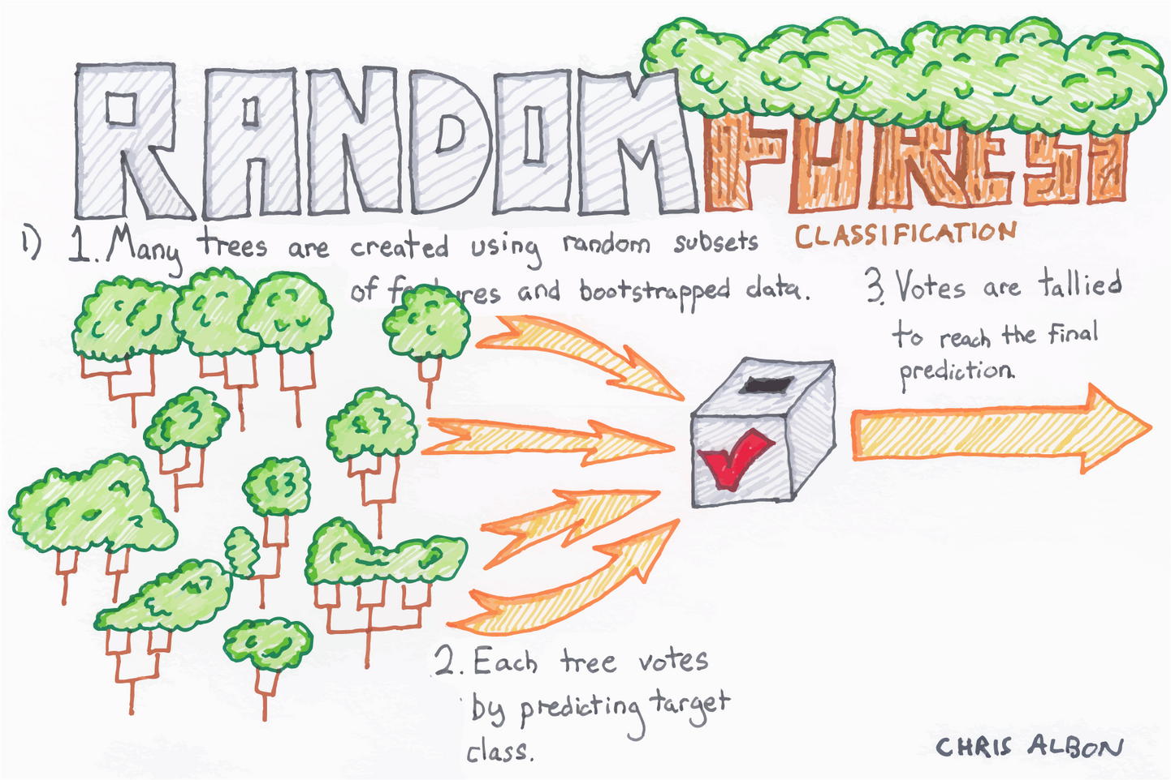
RANDOM FORESTS
Chris Albon said it all!
Data Squad | Ensemble Learning

Slide 24
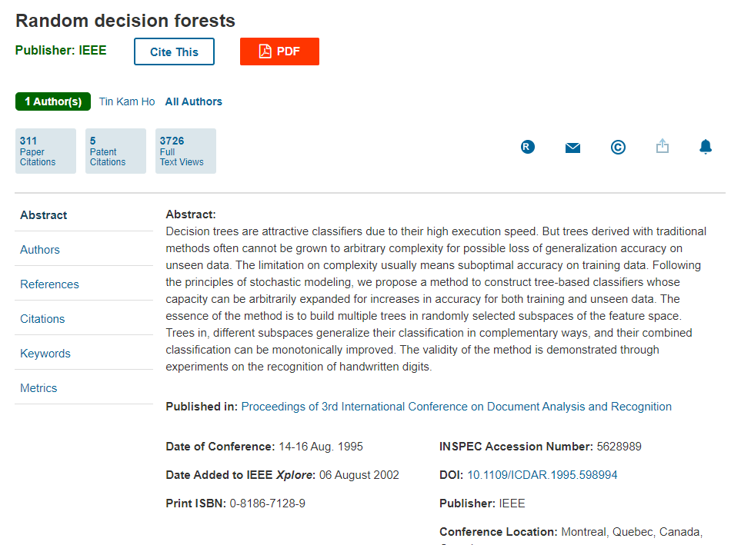
RANDOM FORESTS
The original paper comes from 1995 and the abstract actually gives us a lot of intuition about what's going on!
in each tree of the forest, only a random number of features are consideres for the splitting process!
Data Squad | Ensemble Learning

Slide 25
RANDOM FORESTS
What are the hyperparameters of a random forest algorithm?
n_estimators -> how many trees do we want to initialize?
max_leaf_nodes -> how many final leafs do we want?
max_depth -> how deep do I want my tree to be?
Data Squad | Ensemble Learning

Slide 26
VOTING CLASSIFIERS
JUPYTER (2.2)
Data Squad | Ensemble Learning

Slide 27
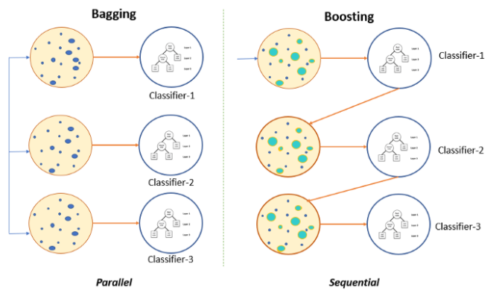
BOOSTING
Data Squad | Ensemble Learning

Slide 28
BOOSTING
Any Ensemble method that can combine weak learners into a strong learner
The main idea is to train predictors sequentially whereby the next tries to "correct" its predecessor
There are two common methods that are the most popular:
- AdaBoost (Adaptive Boosting)
- Gradient Bosting
Data Squad | Ensemble Learning

Slide 29
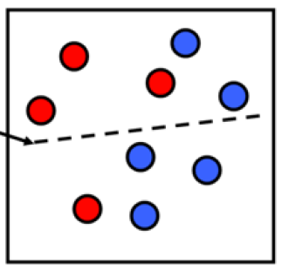
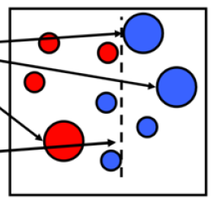
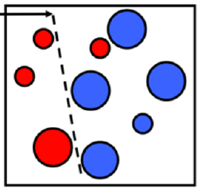
ADA BOOSTING
In adaboosting each new classifier looks at the previous and tries to see on which training instances did he seem to underfit
This results in a new prediction focusing on those cases.
Weak classifier 1
Weak classifier 2
Weak classifier 3
To discuss - why is this a "weak" classifier
Data Squad | Ensemble Learning

Slide 30
ADA BOOSTING
Weak classifier 1
Weak classifier 2
Weak classifier 3
Data Squad | Ensemble Learning

Slide 31
ADA BOOSTING
Data Squad | Ensemble Learning

Slide 32
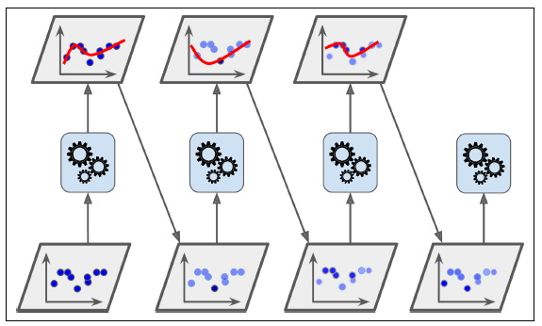
ADA BOOSTING
In adaboosting each new classifier looks at the previous and tries to see on which training instances did he seem to underfit
This results ina new prediction focusing on those cases.
AdaBosting Paper
Data Squad | Ensemble Learning

Slide 33
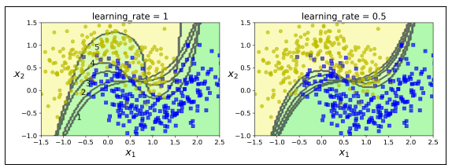
ADA BOOSTING
Once all predictors are trained we still have an ensemble!!
However, the voting method is made giving different weight to each method depending on the overall accuracy
These weights are themselves optimized in the machine learning process
Data Squad | Ensemble Learning

Slide 34
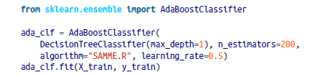
ADA BOOSTING - CODE SNIP
Data Squad | Ensemble Learning

Slide 35
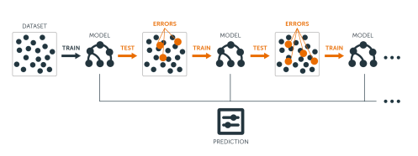
GRADIENT BOOSTING
Similarly to AdaBoost, Gradient Boosting works be sequentially adding predictors to an ensemble each correcting its predecessor.
The difference is that Gradient Boosting tries to fit the new predictor to the residual errors made by the previous predictor
Data Squad | Ensemble Learning

Slide 36
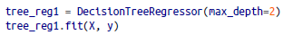
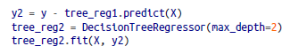
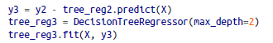

GRADIENT BOOSTING
Sounds confusing, in practice what does this mean?If I have a training dataset X and a target variable y:
Data Squad | Ensemble Learning

Slide 37
GRADIENT BOOSTING
Sounds confusing, in practice what does this mean?If I have a training dataset X and a target variable y:
I am now going to see the mistakes made by my fit
Data Squad | Ensemble Learning

Slide 38
GRADIENT BOOSTING
Sounds confusing, in practice what does this mean?If I have a training dataset X and a target variable y:
I am now going to see the mistakes made by my fit
Compute the array of those mistakes
and then try to create a model that based on the input features X, predicts the errors!!!
Data Squad | Ensemble Learning

Slide 39
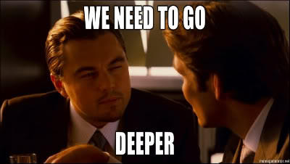
GRADIENT BOOSTING
Sounds confusing, in practice what does this mean?If I have a training dataset X and a target variable y:
Cool, now why don't I repeat that and tree to see the error I have in predicting the errors
Data Squad | Ensemble Learning

Slide 40
GRADIENT BOOSTING
Sounds confusing, in practice what does this mean?If I have a training dataset X and a target variable y:
Cool, now why don't I repeat that and tree to see the error I have in predicting the errors
Data Squad | Ensemble Learning

Slide 41
GRADIENT BOOSTING
Sounds confusing, in practice what does this mean?If I have a training dataset X and a target variable y:
Finally, I have 3 models:
one for y
one for the error in y
one for the error in the error in y
pass a new datapoint through the 3 and add the results!!!
Data Squad | Ensemble Learning

Slide 42
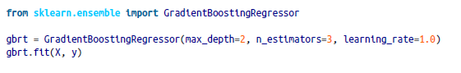
GRADIENT BOOSTING - CODE SNIP
This code is equivalent to the previous examples
Data Squad | Ensemble Learning

Slide 43
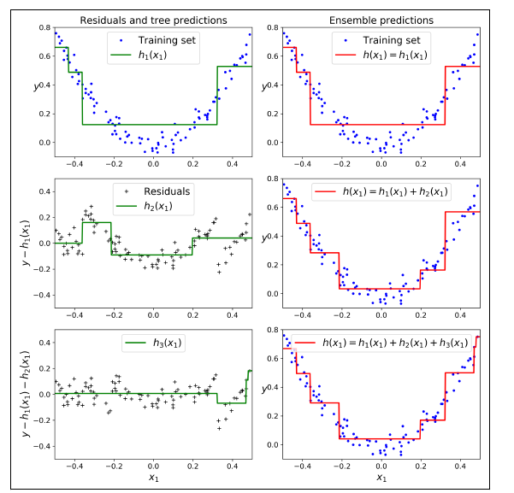
GRADIENT BOOSTING - VISUAL MEANING
Data Squad | Ensemble Learning

Slide 44
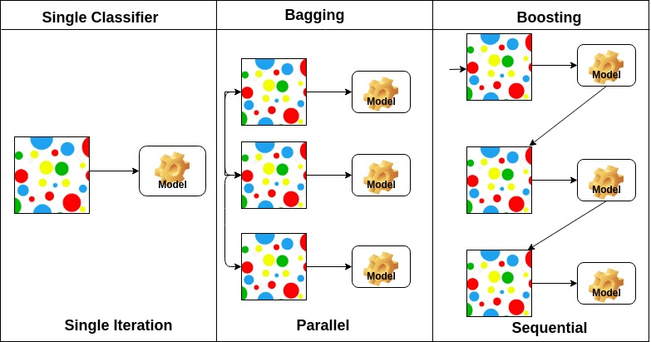
SUMMING UP
Data Squad | Ensemble Learning

Slide 45
ANY QUESTIONS ?

